Slide 1
Session 8
IO, File, Multithreading

Slide 2
I/O Streams in Java
In Java I/O (Input/Output), a stream is a sequence of data that flows from a source to a destination. Streams provide a way to read data from or write data to different sources and destinations, such as files, network connections, memory, etc.
Streams are a fundamental concept in Java for performing I/O operations efficiently.
Two types of I/O: Byte Stream and Character Stream.
Byte Streams are used for reading/writing raw binary data, while
Character Streams are used for reading/writing character data.
Two types of streams:
Input Streams (for reading data)
Output Streams (for writing data)

Slide 3
Input Streams
Read data from a source. Commonly used classes: `InputStream`, `FileInputStream`, `BufferedInputStream`, `DataInputStream`, etc.
Example: Reading from a file. try (FileInputStream fis = new FileInputStream("input.txt")) { int data; while ((data = fis.read()) != -1) { System.out.print((char) data); } } catch (IOException e) { e.printStackTrace(); }
try (Reader reader = new FileReader("text.txt")) {
int character;
while ((character = reader.read()) != -1) {
// Process the character
System.out.print((char) character);
}
} catch (IOException e) {
e.printStackTrace();
}

Slide 4
Output Streams
Write data to a destination.
Commonly used classes: `OutputStream`, `FileOutputStream`, `BufferedOutputStream`, `DataOutputStream`, etc.
Example: Writing to a file. try (FileOutputStream fos = new FileOutputStream("output.txt")) { String data = "Hello, I/O Streams!"; fos.write(data.getBytes()); } catch (IOException e) { e.printStackTrace(); }

Slide 5
File Class
The `File` class in Java represents a file or directory path. Commonly used methods: `exists()`, `isFile()`, `isDirectory()`, `getName()`, `getParent()`, etc.
Example: Checking if a file exists. File file = new File("input.txt"); if (file.exists() && file.isFile()) { System.out.println("File exists."); } else { System.out.println("File does not exist."); }

Slide 6
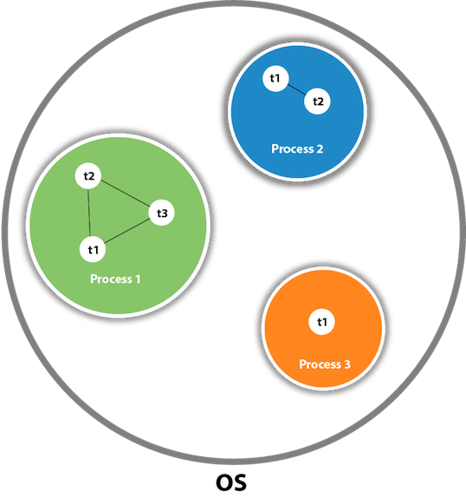
Multithreading in Java
A mechanism in Java that allows concurrent execution of multiple threads within a process. Advantages: Improved performance, responsiveness, and resource utilization.
A thread is a lightweight subprocess, the smallest unit of processing. It is a separate path of execution.
Threads are independent. If there occurs exception in one thread, it doesn't affect other threads. It uses a shared memory area.
Two ways to create threads: Extending `Thread` class or implementing `Runnable` interface.
Refer for more: https://www.javatpoint.com/multithreading-in-java

Slide 7
Creating Threads
Extending `Thread` class: class MyThread extends Thread { public void run() { // Code to be executed by the thread } } MyThread thread = new MyThread(); thread.start(); // Start the thread Implementing `Runnable` interface: class MyRunnable implements Runnable { public void run() { // Code to be executed by the thread } } MyRunnable runnable = new MyRunnable(); Thread thread = new Thread(runnable); thread.start(); // Start the thread

Slide 8
Thread Synchronization
//example of java synchronized method
class Table{
synchronized void printTable(int n){//synchronized method
for(int i=1;i<=5;i++){
System.out.println(n*i);
try{
Thread.sleep(400);
}catch(Exception e){System.out.println(e);}
}
}
}
class MyThread1 extends Thread{
Table t;
MyThread1(Table t){
this.t=t;
}
public void run(){
t.printTable(5);
}
}
class MyThread2 extends Thread{
Table t;
MyThread2(Table t){
this.t=t;
}
public void run(){
t.printTable(100);
}
}
public class TestSynchronization2{
public static void main(String args[]){
Table obj = new Table();//only one object
MyThread1 t1=new MyThread1(obj);
MyThread2 t2=new MyThread2(obj);
t1.start();
t2.start();
}
}
In multithreaded applications, multiple threads may access shared resources concurrently, leading to data inconsistency.
Synchronization ensures that only one thread can access a shared resource at a time.
Use `synchronized` keyword for synchronization.
Refer : https://www.javatpoint.com/synchronization-in-java

Slide 9
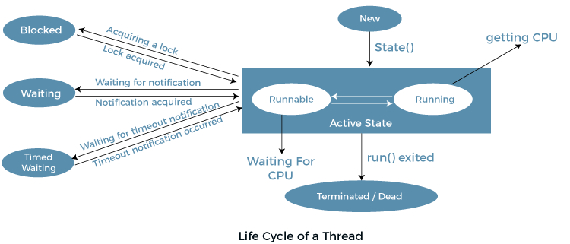
Thread States
Threads can be in different states, such as `NEW`, `RUNNABLE`, `BLOCKED`, `WAITING`, `TIMED_WAITING`, and `TERMINATED`.
Java provides methods like `getState()` and `isAlive()` to check a thread's state.
Refer : https://www.javatpoint.com/life-cycle-of-a-thread

Slide 10
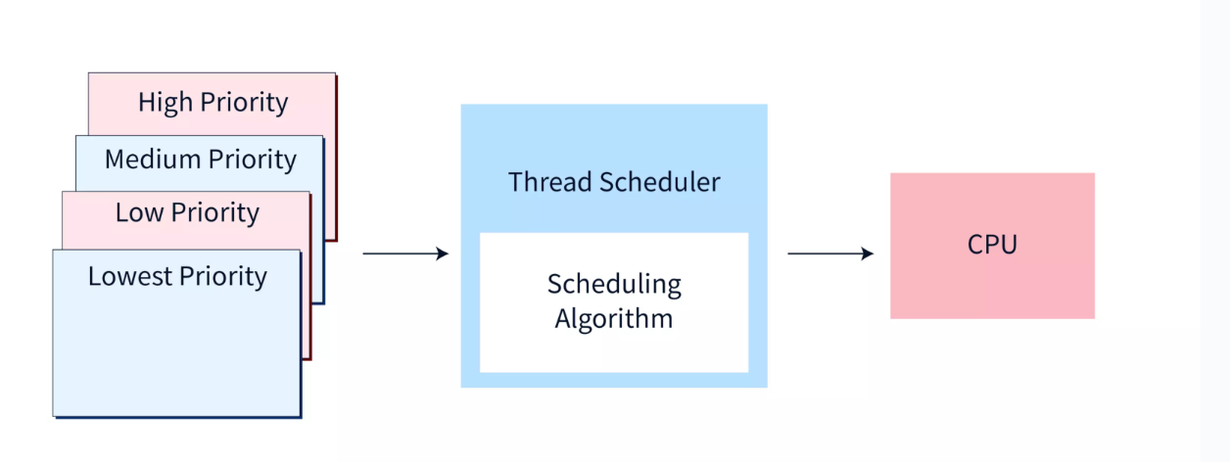
Thread Priority
Threads can have priorities ranging from 1 (lowest) to 10 (highest). Higher priority threads get preference in CPU execution. Use `setPriority()` and `getPriority()` methods to set and get thread priorities.

Slide 11
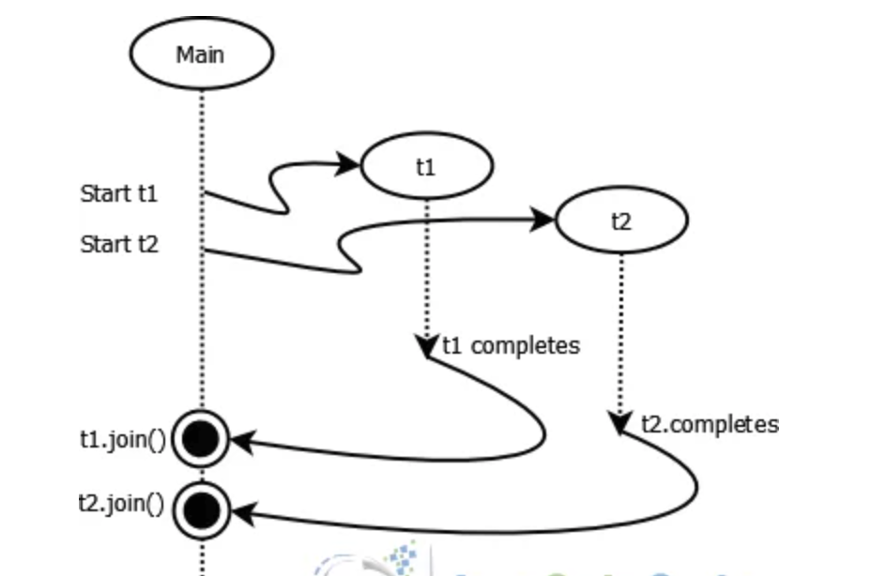
Thread Joining
The `join()` method allows one thread to wait for the completion of another thread. Useful for synchronization or waiting for results from multiple threads.

Slide 12
Thread Intercommunication
Inter-thread communication or Co-operation is all about allowing synchronized threads to communicate with each other.
Inter-thread communication is a mechanism in which a thread is paused running in its critical section and another thread is allowed to enter (or lock) in the same critical section to be executed.It is implemented by following methods of Object class:
wait()
notify()
notifyAll()
class Customer{
int amount=10000;
synchronized void withdraw(int amount){
System.out.println("going to withdraw...");
if(this.amount<amount){
System.out.println("Less balance; waiting for deposit...");
try{wait();}catch(Exception e){}
}
this.amount-=amount;
System.out.println("withdraw completed...");
}
synchronized void deposit(int amount){
System.out.println("going to deposit...");
this.amount+=amount;
System.out.println("deposit completed... ");
notify();
}
}
class Test{
public static void main(String args[]){
final Customer c=new Customer();
new Thread(){
public void run(){c.withdraw(15000);}
}.start();
new Thread(){
public void run(){c.deposit(10000);}
}.start();
}}

Slide 13
Thread Pooling
Java Thread pool represents a group of worker threads that are waiting for the job and reused many times.
In the case of a thread pool, a group of fixed-size threads is created. A thread from the thread pool is pulled out and assigned a job by the service provider. After completion of the job, the thread is contained in the thread pool again.
Thread pooling improves application performance by reusing threads from a pool instead of creating new threads each time. Java provides `ExecutorService` and `ThreadPoolExecutor` classes for thread pooling.

Slide 14
Example
public class SimpleMultithreadedProgram {
public static void main(String[] args) {
// Create two threads
Thread thread1 = new NumberPrinterThread("Thread 1");
Thread thread2 = new NumberPrinterThread("Thread 2");
// Start the threads
thread1.start();
thread2.start();
}
// Custom Thread class to print numbers
static class NumberPrinterThread extends Thread {
private final String threadName;
public NumberPrinterThread(String name) {
threadName = name;
}
public void run() {
for (int i = 1; i <= 10; i++) {
System.out.println(threadName + ": " + i);
try {
// Pause the thread for a short time
Thread.sleep(500);
} catch (InterruptedException e) {
e.printStackTrace();
}
}
}
}
}
In this program, we create a NumberPrinterThread class that extends the Thread class. This custom thread class overrides the run() method, where we put the code that will be executed by the thread. The thread prints numbers from 1 to 10 along with its thread name and pauses for a short time (500 milliseconds) between each number using Thread.sleep().
In the main() method, we create two threads using the NumberPrinterThread class and start them using the start() method. When the program runs, the two threads will print numbers simultaneously, demonstrating the concept of multithreading.

Slide 15
Key notes
I/O (Input/Output) in Java:
- I/O involves the transfer of data between an application and external resources like files, streams, network sockets, etc.
- Java provides two types of I/O: Byte Stream and Character Stream.
Byte Streams and Character Streams:
- Byte Streams are used for reading/writing raw binary data, while Character Streams are used for reading/writing character data.
- `InputStream` and `OutputStream` are the base classes for byte streams.
- `Reader` and `Writer` are the base classes for character streams.
File Handling in Java:
- The `File` class represents file and directory paths.
- File operations include creating, deleting, reading, and writing files.
Reading from Files:
- Java offers various classes like `FileInputStream` and `BufferedReader` for reading from files.
- Buffering improves reading performance using a buffer memory.
Writing to Files:
- Java provides classes like `FileOutputStream` and `BufferedWriter` for writing to files.
- Using `try-with-resources` ensures that resources are automatically closed.

Slide 16
Keynotes contd..
Multithreading in Java:
- Multithreading allows multiple threads to run concurrently within a single process.
- Threads are lighter than processes and share the same memory space.
Creating Threads:
- Threads can be created by extending the `Thread` class or implementing the `Runnable` interface.
- Extending `Thread` class: Override the `run()` method.
- Implementing `Runnable` interface: Implement the `run()` method and create a thread using `Thread` constructor.
Thread States:
- Threads go through various states: `NEW`, `RUNNABLE`, `BLOCKED`, `WAITING`, `TIMED_WAITING`, and `TERMINATED`.
- `RUNNABLE` means a thread is executing or ready for execution.
Synchronization:
- Synchronization is important to avoid data inconsistency in multithreaded programs.
- The `synchronized` keyword ensures that only one thread can access a block of code or an object at a time.
Thread Safety:
- Thread-safe classes are designed to work correctly when accessed concurrently by multiple threads.
- Classes can be made thread-safe using synchronization or thread-safe data structures.
Thread Priority:
- Threads have priorities ranging from 1 (lowest) to 10 (highest).
- Priority affects the order in which threads are scheduled to run.
Daemon Threads:
- Daemon threads are background threads that don't prevent the program from exiting when they are still running.
Thread Pooling:
- Thread pooling improves performance by reusing threads.
- Java provides `ExecutorService` and `ThreadPoolExecutor` for thread pooling.
Challenges of Multithreading:
- Multithreading introduces challenges like race conditions, deadlocks, and resource contention.
- Careful design and synchronization are essential to avoid these issues.

